Slide 1

Continuous Integration after Hudson, CruiseControl, and Home Built
Mile High Agile 2011 – Mark Waite

Slide 2
Improving Your Productivity
Continuous integration can help you go faster
  Detect build breaks sooner
  Report failing tests more clearly
  Make progress more visible

Slide 3

Jenkins for Continuous Integration
Jenkins – open source continuous integration server
Jenkins (http://jenkins-ci.org/) is
  Easy to install
  Easy to use
  Multi-technology
  Multi-platform
  Widely used
  Extensible
  Free

Slide 4
Jenkins for a Developer
Easy to install
  Download one file – jenkins.war
  Run one command – java –jar jenkins.war
Easy to use
  Create a new job – checkout and build a small project
  Checkin a change – watch it build
  Create a test – watch it build and run
  Fix a test – checkin and watch it pass
Multi-technology
  Build C, Java, C#, Python, Perl, SQL, etc.
  Test with Junit, Nunit, MSTest, etc.

Slide 5
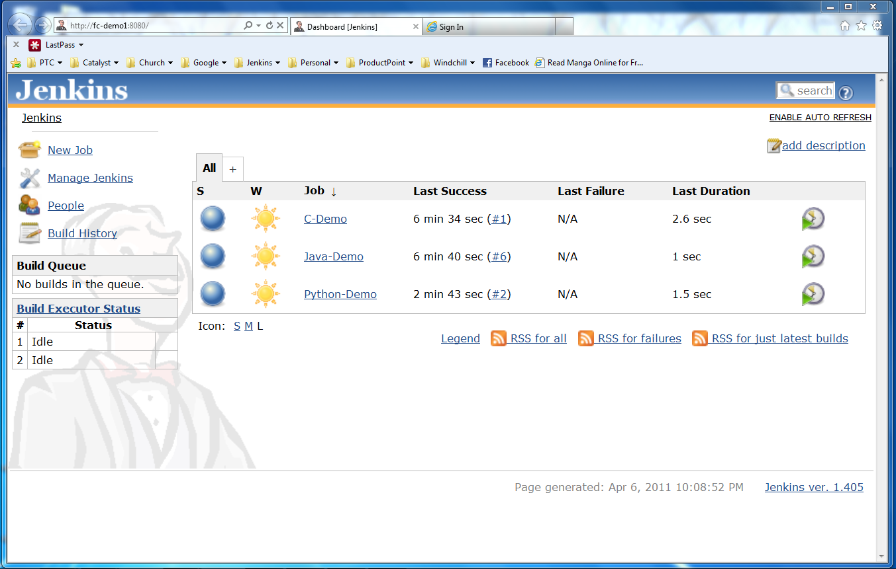
Jenkins User Interface
Actions
Nodes
Jobs

Slide 6
Developer demo goes here…
Create a new job from a Subversion repository
Build that code, see build results
Run its tests, see test results
Make a change and watch it run through the system
Languages
  Java
  C
  Python

Slide 7
More Power – Jenkins Plugins
Jenkins has over 300 plugins
  Software configuration management
  Builders
  Test Frameworks
  Virtual Machine Controllers
  Notifiers
  Static Analyzers

Slide 8
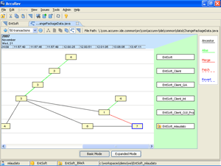

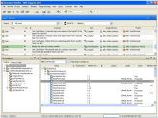




Jenkins Plugins - SCM
Version Control Systems
  Accurev
  Bazaar
  BitKeeper
  ClearCase
  Darcs
  Dimensions
  Git
  Harvest
  MKS Integrity
  PVCS
  StarTeam
  Subversion
  Team Foundation Server
  Visual SourceSafe

Slide 9
Jenkins Plugins – Build & Test
Build Tools
  Ant
  Maven
  MSBuild
  Cmake
  Gradle
  Grails
  Scons
  Groovy
Test Frameworks
  Junit
  Nunit
  MSTest
  Selenium
  Fitnesse

Slide 10
Jenkins Plugins – Analyzers
Static Analysis
  Checkstyle
  CodeScanner
  DRY
  Crap4j
  Findbugs
  PMD
  Fortify
  Sonar
  FXCop
Code Coverage
  Emma
  Cobertura
  Clover
  GCC/GCOV

Slide 11
Jenkins Plugins – Other Tools
Notification
  Twitter
  Campfire
  Google Calendar
  IM
  IRC
  Lava Lamp
  Sounds
  Speak
Authorization
  Active Directory
  LDAP
Virtual Machines
  Amazon EC2
  VMWare
  VirtualBox
  Xen
  Libvirt

Slide 12
Jenkins for Teams
Multi-configuration jobs
Multi-stage jobs
Swarms to dynamically contribute capacity

Slide 13
Jenkins for Teams Demo here…
This is where the bigger Jenkins demo is inserted

Slide 14
Jenkins – Integration for You
Jenkins can help your development be
  Faster
  Safer
  Easier
  Smarter

